Slide 1
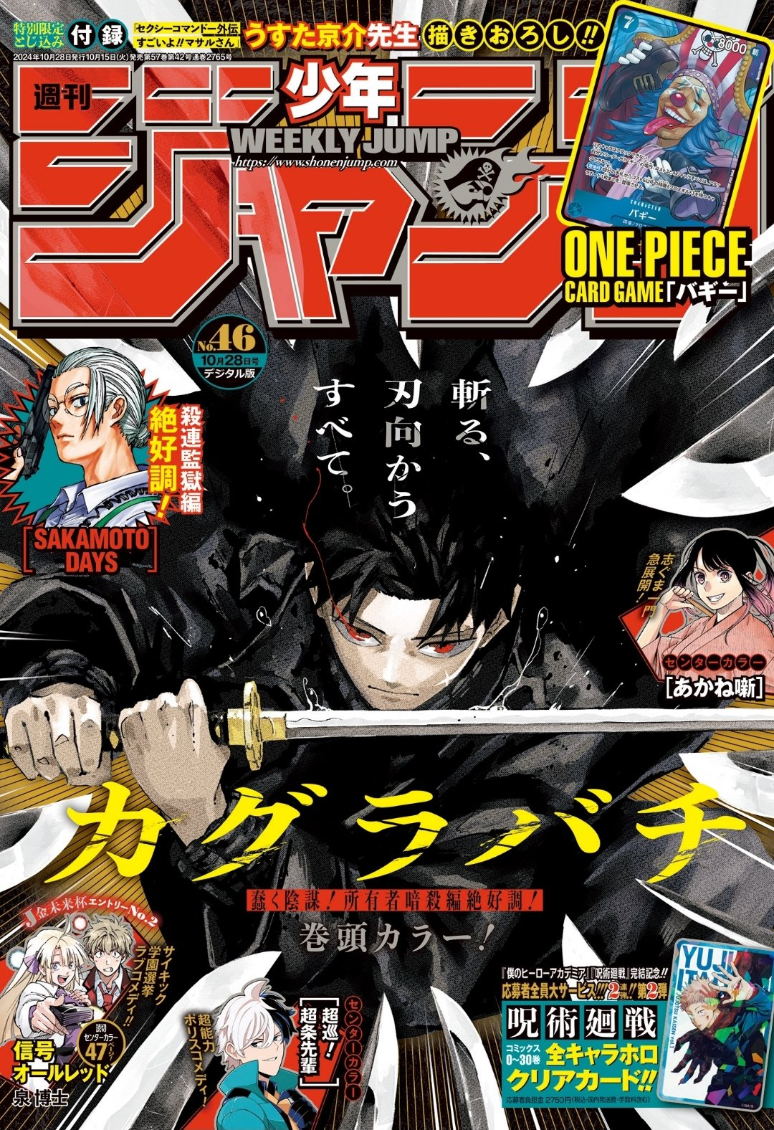
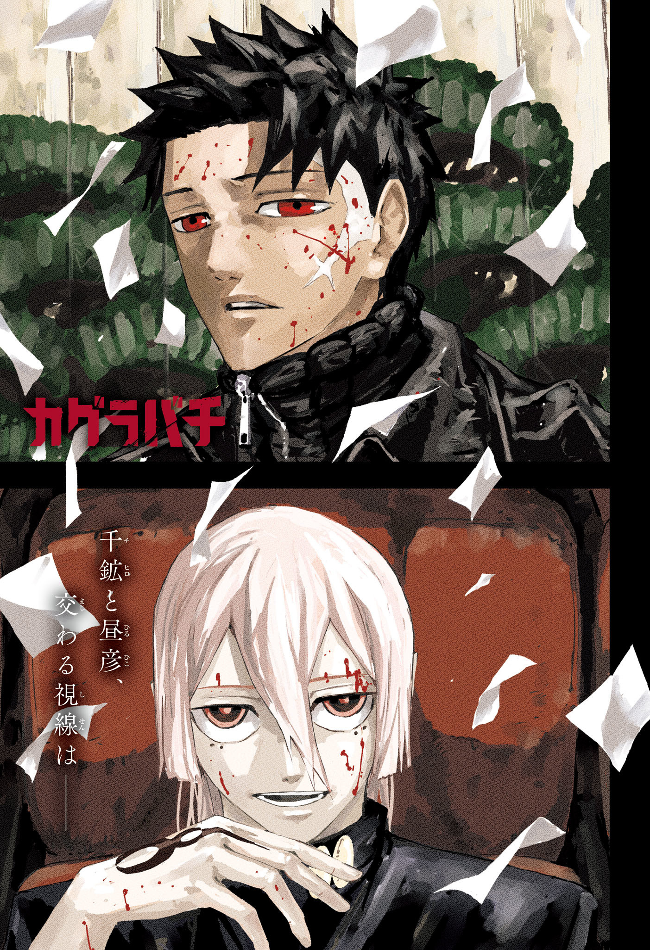




#46
#46
#46
#46
#46
#46
#46

Slide 2
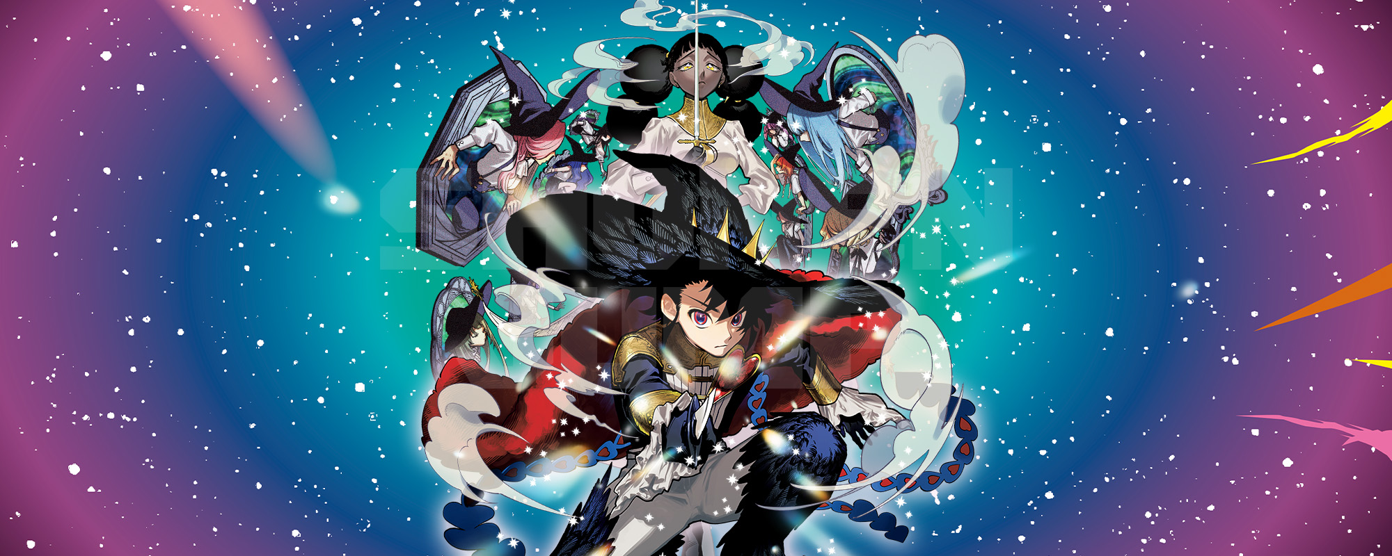
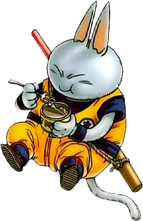
Ichi the Witch (#6)

Slide 3
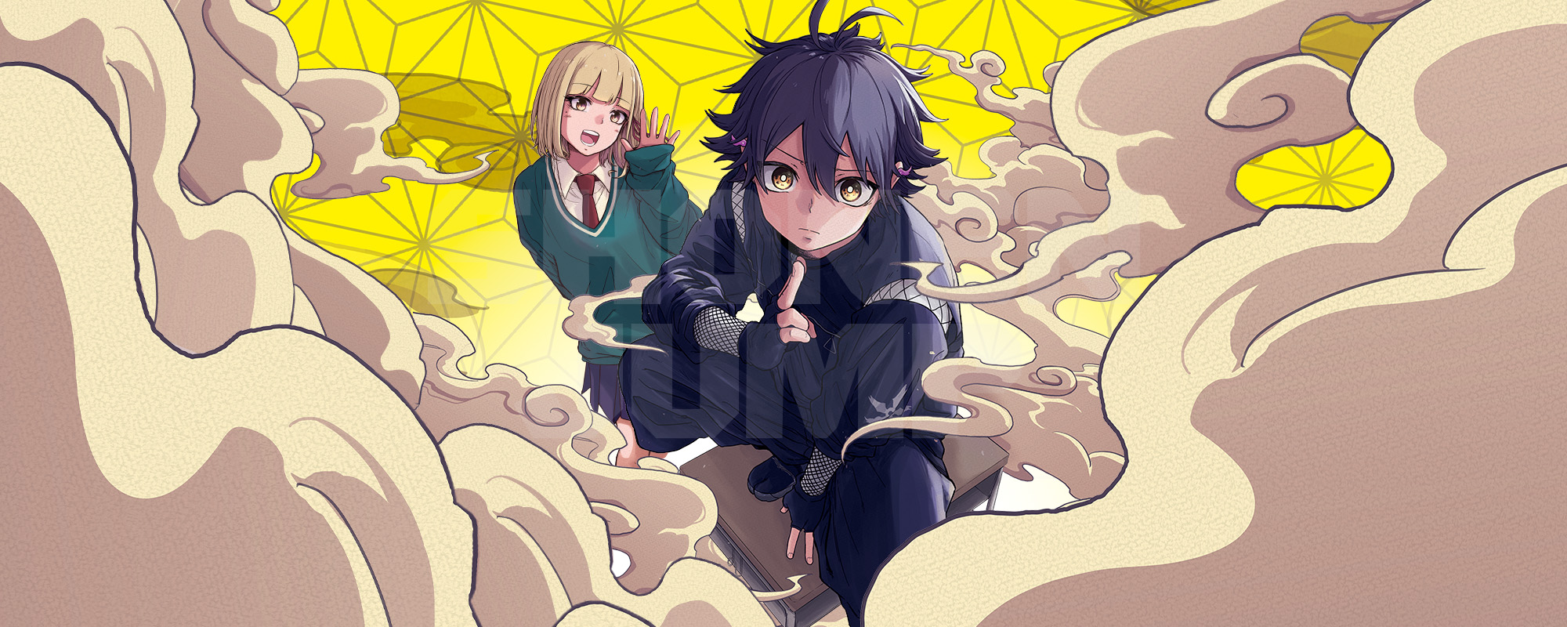
Shinobi Undercover (#5)

Slide 4

Hakutaku (#4)

Slide 5
Couverture
Kagurabachi

Slide 6
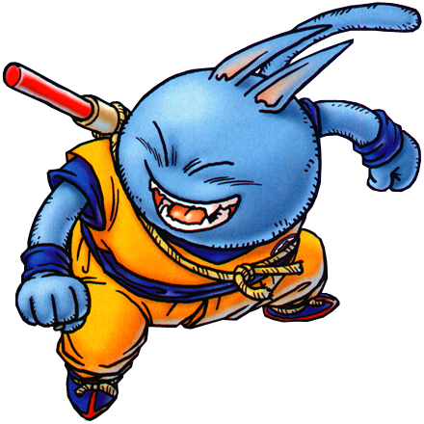

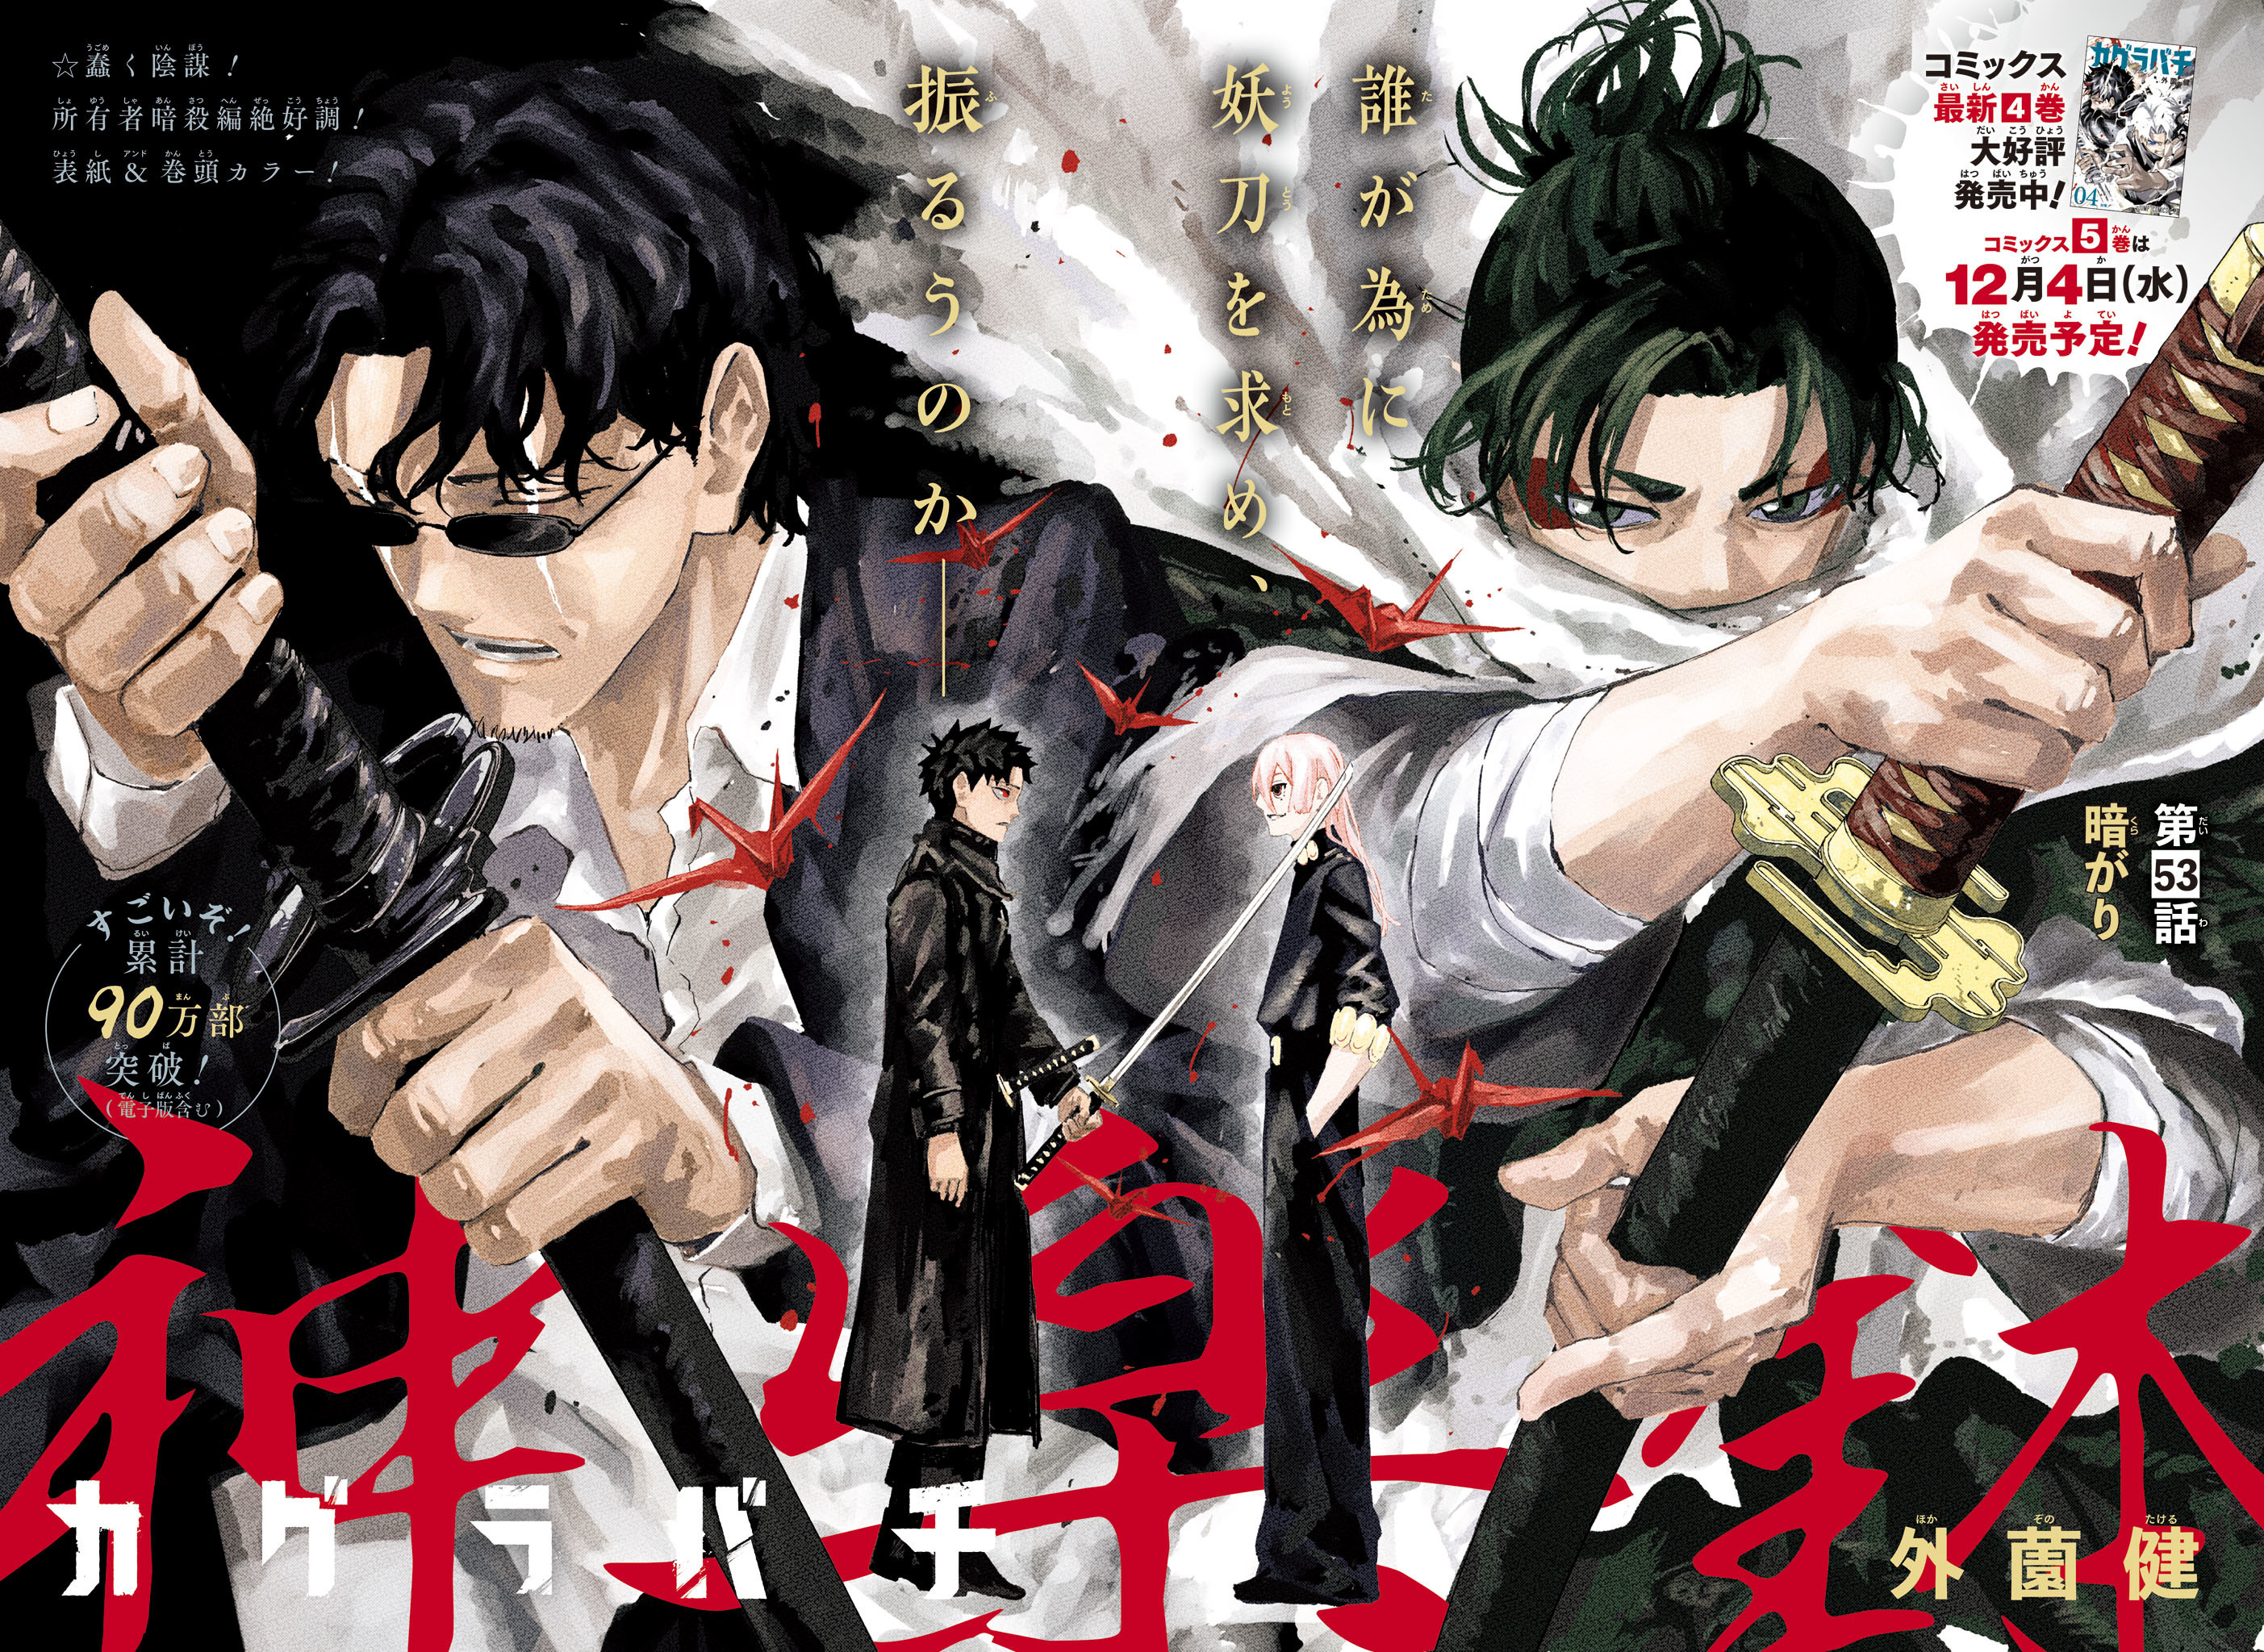
Kagurabachi (#53)

Slide 7
Kagurabachi (#53)

Slide 8

Couverture
Ventes :
60 704
En 3 jours
Kagurabachi

Slide 9
Akane-banashi (#130)

Slide 10
Signal All Red

Slide 11

Super Psychic Policeman Chojo (#34)

Slide 12
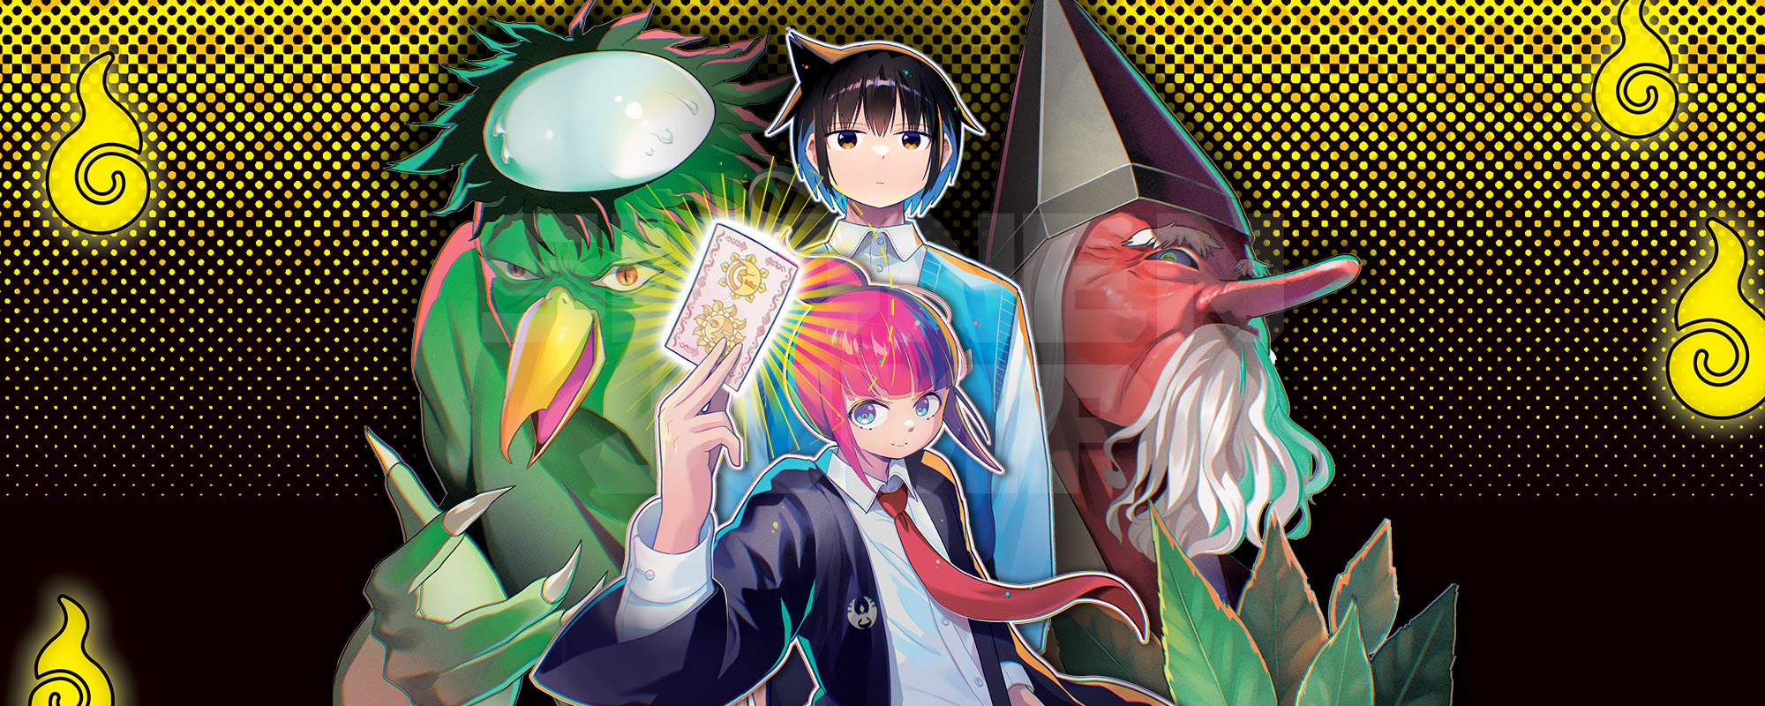
Yokai Buster Murakami(#17)

Slide 13

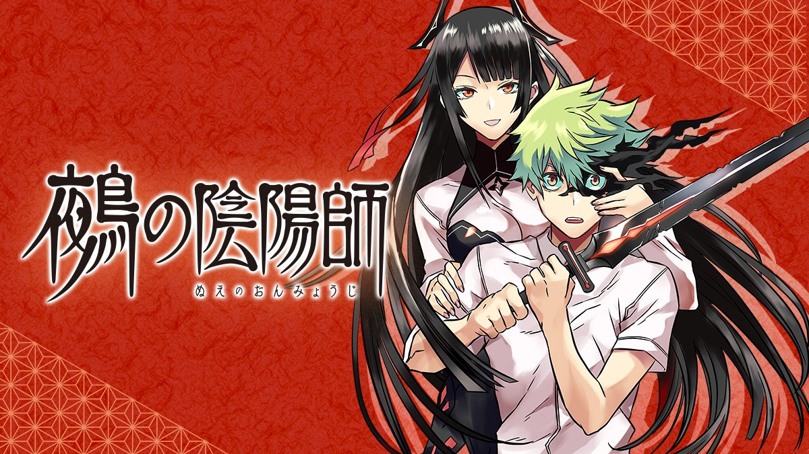
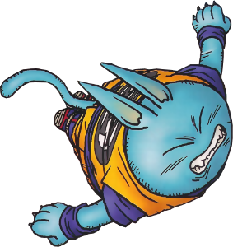
14
-4
Nue's Exorcist(#70)

Slide 14

13
-5
Mission: Yozakura Family(#246)

Slide 15

13
-5
Ventes :
13 062
En 3 jours
Mission: Yozakura Family(#246)

Slide 16

12
+1
Kill Blue(#73)

Slide 17

11
-7
Astro Royale(#25)

Slide 18

11
-7
Ventes :
11 170
En 3 jours
Astro Royale(#25)

Slide 19

10
in!
Hima-Ten!(#14)

Slide 20
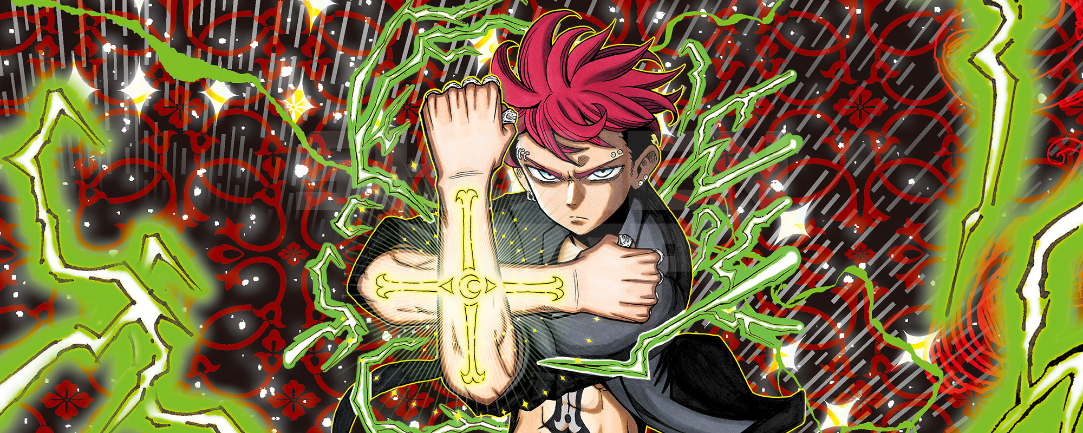
9
+3
Ultimate Exorcist Kiyoshi(#16)

Slide 21

8
-3
Me and Roboco(#205)

Slide 22

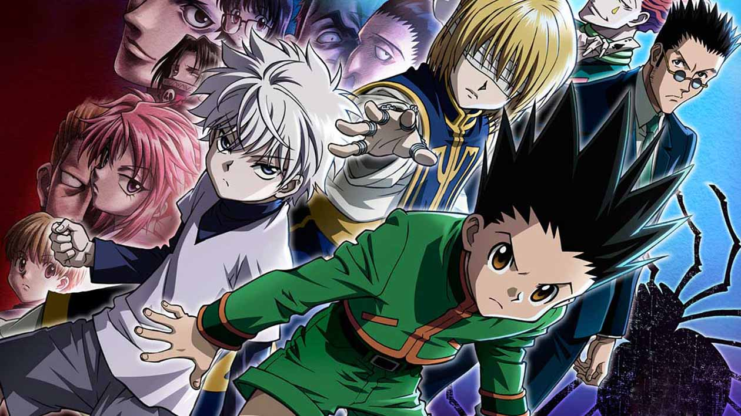
8
in!
Hunter × Hunter(#402)

Slide 23


8
+5
Undead Unluck(#226)

Slide 24

8
+5
Ventes :
12 272
En 3 jours
Undead Unluck(#226)

Slide 25

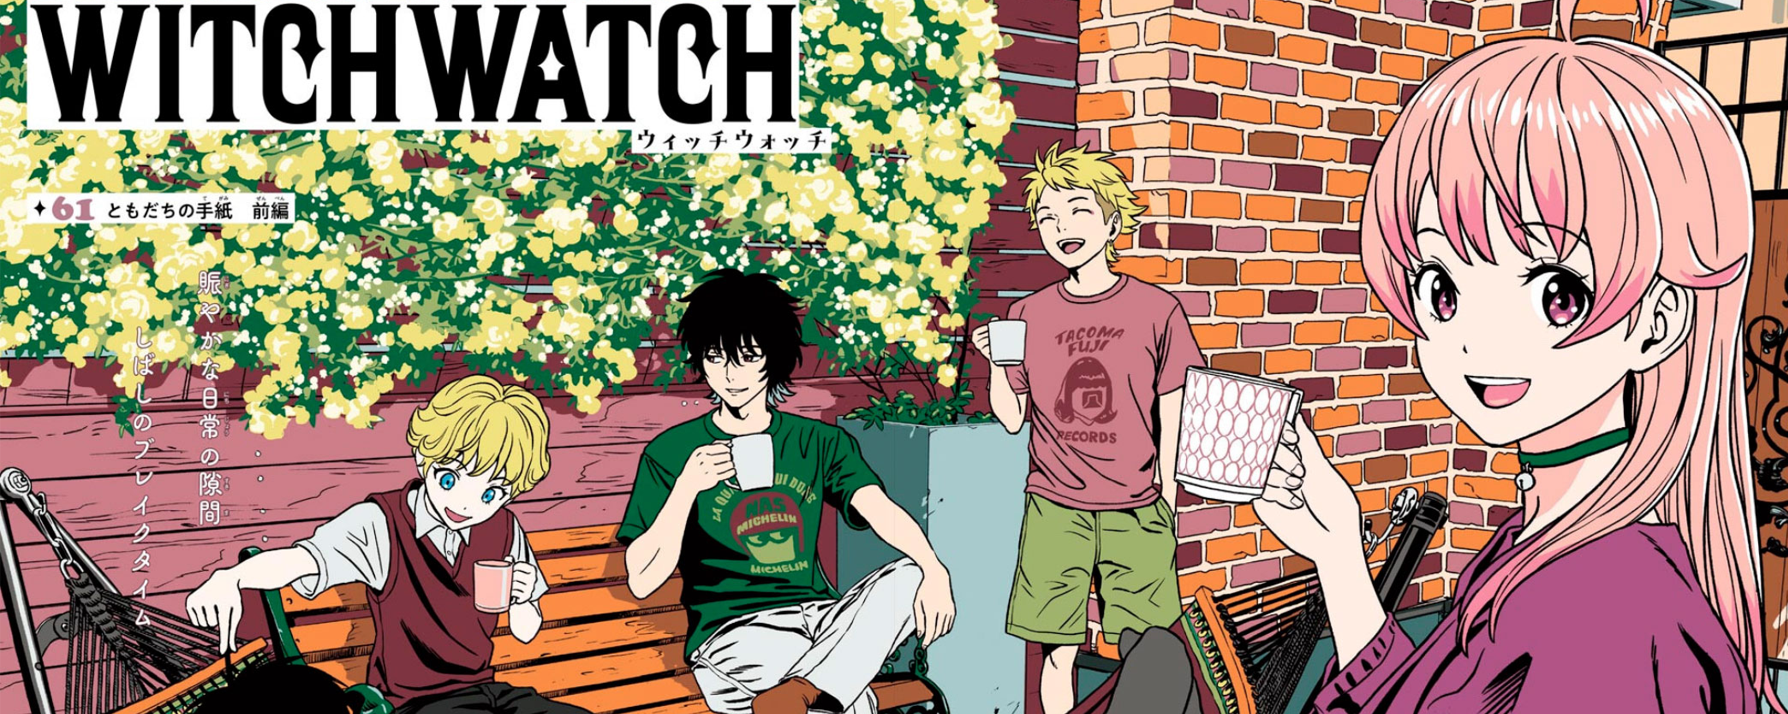
8
+4
Witch Watch(#175)

Slide 26

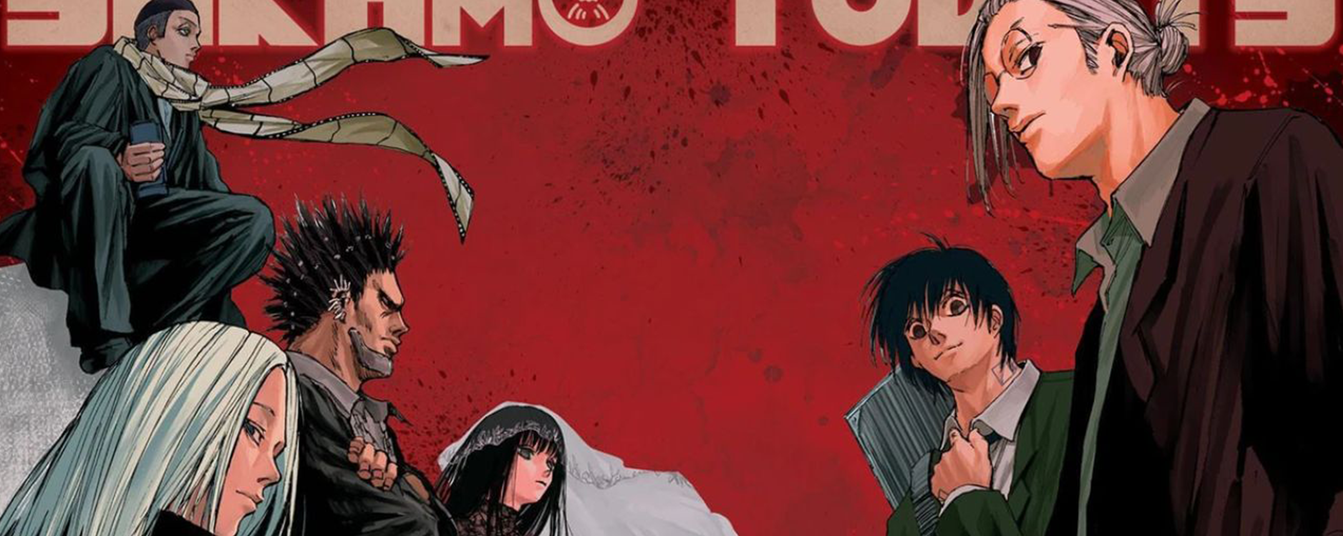
8
in!
Sakamoto Days(#185)

Slide 27

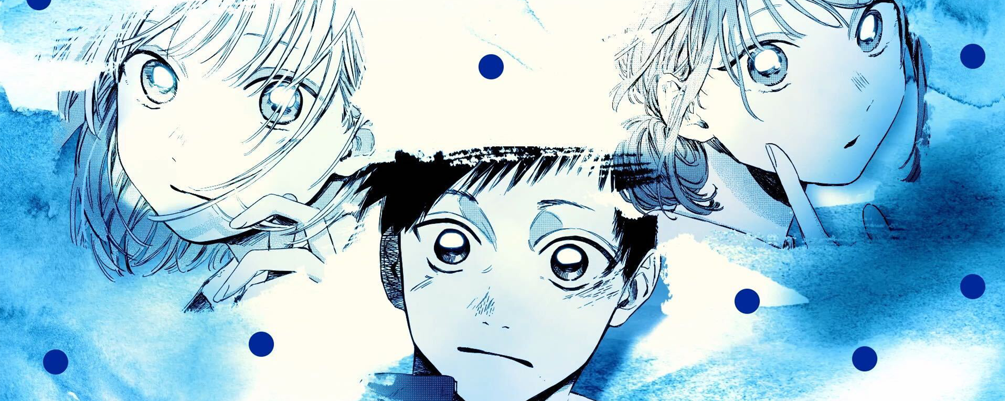
8
-2
Blue Box(#168)

Slide 28

8
-2
Ventes :
43 864
En 3 jours
Blue Box(#168)

Slide 29

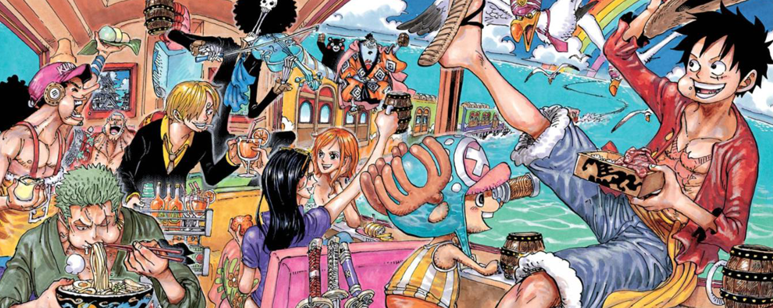
8
in!
One Piece(#1129)

Slide 30

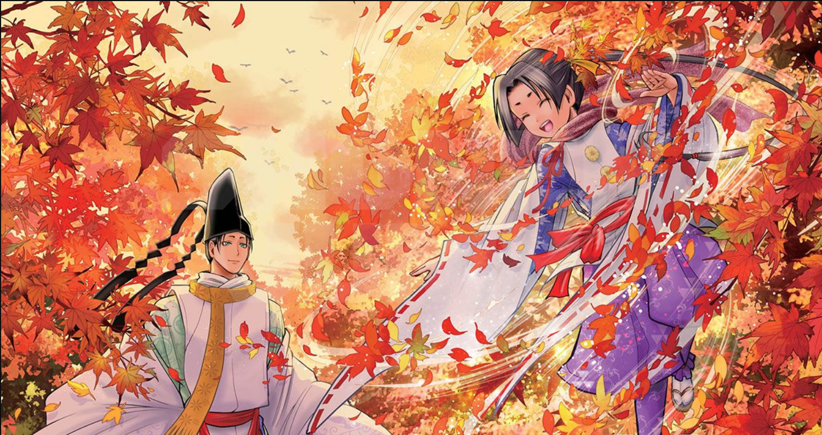
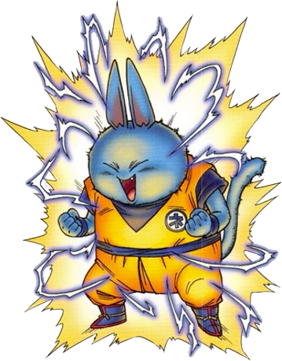
8
+6
The Elusive Samurai(#176)

Slide 31
#46
#46
#46
#46
#46
#46
#46

